Slide 1
Parent PLUS Borrowing: Repayment Experiences and Impacts
Wednesday, February 19, 2020
Presented by:
Jeff Webster, Director of Research, Trellis Company
Carla Fletcher, Senior Research Analyst, Trellis Company
Wenhua Di, Senior Research Economist, Federal Reserve Bank of Dallas

Slide 2
About Trellis Company
Trellis Company (www.trelliscompany.org) is a nonprofit 501(c)(3) corporation with the dual mission of helping student borrowers successfully repay their education loans and promoting access and success in higher education.
For nearly 40 years, Trellis Company has provided individualized services to student loan borrowers and support to institutions and communities.
Trellis offers the Student Financial Wellness Survey (SFWS) free of charge to institutions as part of our community investment work.

Slide 3
About Trellis Research
Trellis Research provides colleges and policymakers insight into student success through the lens of college affordability.
We invite you to visit our library of publications at www.trelliscompany.org/research.
Please follow us on Twitter @TrellisResearch for notifications of new research publications and discussions of a variety of higher education topics.
We collaborated with Wenhua Di from the Federal Reserve Bank of Dallas for this research. The views expressed in the report are the authors’ and do not represent the views of the Federal Reserve Bank of Dallas or the Federal Reserve System

Slide 4

PLUS Borrowing in Texas: Repayment Expectations, Experience, and Hindsight by Minority-Serving Institution Status

Slide 5
Parent PLUS History
1980: Parent PLUS program introduced
1993: Annual and lifetime maximum limits lifted to allow borrowing up to the cost of attendance
2011: Underwriting standards tightened, resulting in an increase in loan denials (later changed to be less stringent)

Slide 6
Parent PLUS History
Source: The College Board, “Trends in College Pricing 2018”

Slide 7
Parent PLUS History
Source: Looney & Lee 2018 report in Brookings, “Parents are borrowing more and more to send their kids to college – and many are struggling to repay”

Slide 8
Parent PLUS History
Source: Department of Education, Federal Student Aid, “Title IV Program Volume Reports”

Slide 9
Parent PLUS History
Source: Looney & Lee 2018 report in Brookings, “Parents are borrowing more and more to send their kids to college – and many are struggling to repay”

Slide 10
Methodology
Analysis of Trellis Loan Records
Trellis’ Federal Family Education Loan Program (FFELP) portfolio
59,096 Parent PLUS borrowers
Child they borrowed for attended a Texas institution
Entered repayment between October 2004 and September 2010 and were tracked for first 7 years of repayment

Slide 11
Methodology
Analysis of Parent Interviews
49 Parent PLUS borrowers
Interviewed by telephone
Had a variety of repayment outcomes, graduation statuses, school types, and loan amounts – not representative, but people with different experiences

Slide 12
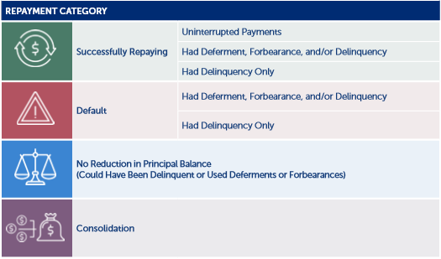
Analysis Groups
Minority-Serving Institutions – if child attended a Hispanic-Serving Institution (HSI) or a Historically Black College and University (HBCU)
Repayment Experience

Slide 13
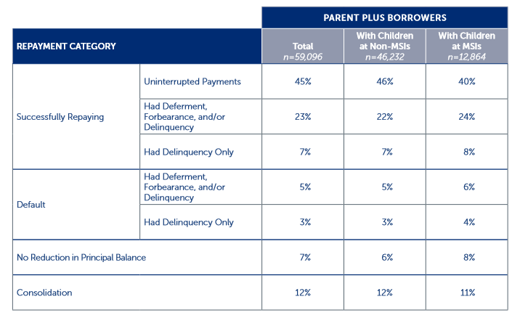
Findings
What Does Repayment Look Like for PLUS Borrowers?

Slide 14
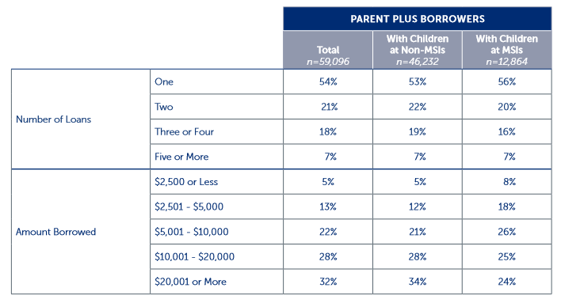
Findings
What Does Repayment Look Like for PLUS Borrowers?

Slide 15
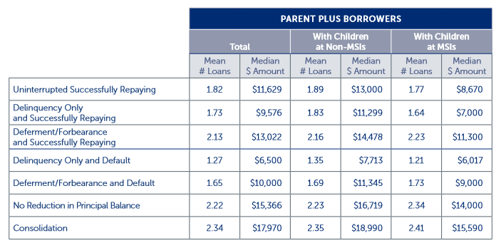
Findings
What Does Repayment Look Like for PLUS Borrowers?

Slide 16
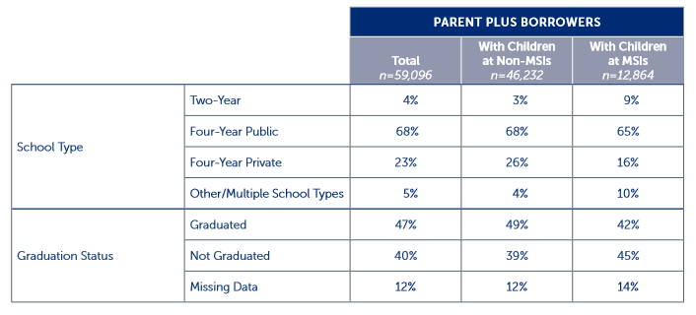
Findings
What Does Repayment Look Like for PLUS Borrowers?

Slide 17
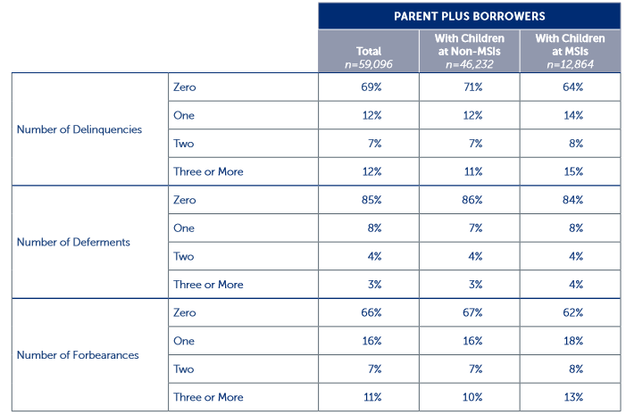
Findings
What Does Repayment Look Like for PLUS Borrowers?

Slide 18
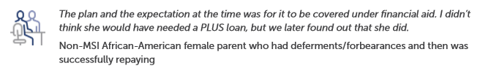
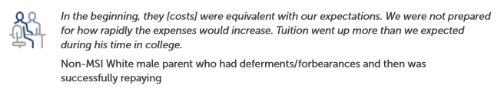
Findings
What Do Parents Know Before They Borrow?
Most parents we interviewed expected loans to be part of paying for college. Some talked of having to borrow more than expected.

Slide 19
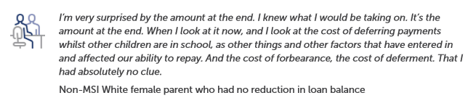
Findings
What Do Parents Know Before They Borrow?
Many parents did not have a good understanding of how much debt they would incur.

Slide 20

Findings
Who Repays The Parent PLUS Loans?
Most parents expected to repay the PLUS loans themselves without help from their children.
Those who expected help often cited events like graduating, getting a job, or paying off student loans.

Slide 21

Findings
Other Financial Decisions: General Savings
Repayment had a highly variable impact on general savings.
Those reporting a low impact described budgeting payments like any other bill
Those reporting a high impact said payments consumed a large portion of their income.

Slide 22
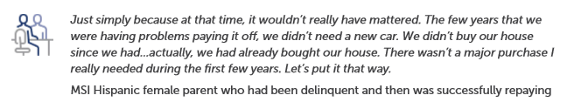
Findings
Other Financial Decisions: Major Purchases
About half of the parents we interviewed did not feel an impact on their ability to make major purchases.

Slide 23
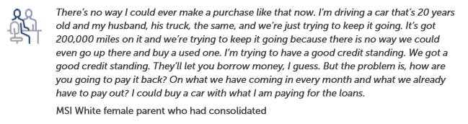
Findings
Other Financial Decisions: Major Purchases
Some who felt a high impact described hanging on to older vehicles for longer than they would have liked.

Slide 24
Findings
Other Financial Decisions: Other Financial Goals
High Impact:
  Bad credit
  Negative impact on home ownership
  Doing without
Some impact:
  Fewer or smaller vacations
  Less money for savings

Slide 25
Findings
Other Financial Decisions: Overall Impact
The majority of parents interviewed said the overall financial impacts of the PLUS loans were expected.
Those surprised by the impact described:
  Length of time to pay off
  Financial detriments
    Total was higher than expected
    Interest accumulation
    Costs of postponing payments

Slide 26



Findings
Other Financial Decisions: Retirement Savings
Parents generally felt moderately comfortable with their retirement savings, though there was variation.

Slide 27
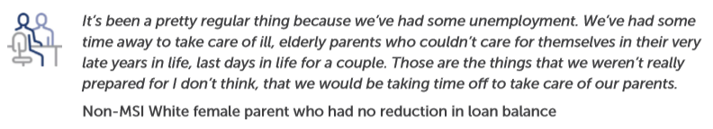


Findings
Do Parents Struggle With Loan Payments?
A majority of the parents interviewed said they had struggled to repay their PLUS loans at some point.
Many parents also were able to help their children repay their loans, or to be a safety net.

Slide 28
Research to Practice
Narrow the Gap in College Costs and Available Aid
Emergency aid programs can reduce the reliance on PLUS borrowing to address emergency situations.
Increase funding for MSIs to enable more institutional grants for needy students.
Strengthen student support efforts – FAFSA awareness, behavioral nudges, financial coaching, data analytics
Redirect federal and state grant eligibility to better address zero EFC students

Slide 29
Research to Practice
Improve Understanding of Rights and Obligations
Design informational materials and provide parent workshops about the Parent PLUS loan program.
Consider including parents in behavioral nudge campaigns.
Provide realistic expectations of the cost of attendance, including for future years.
Initiate a program to guarantee or freeze tuition costs.
Work with local employers and financial counseling firms to include information about PLUS loans in retirement planning sessions.

Slide 30
Questions?
Please follow us on Twitter: @TrellisResearch
Contact Info:
Jeff Webster, Director of Research
Jeff.Webster@trelliscompany.org
Carla Fletcher, Senior Research Analyst
Carla.Fletcher@trelliscompany.org
Wenhua Di, Senior Research Economist
Wenhua.Di@dal.frb.org

