Slide 1
Creating a Campus Culture of Care
University of Oregon
Jimmy Howard, PhD (he/his)
Assistant Dean of Students
Rituparna Roy, LMSW (she/hers)
Assistant Director of Sexual Violence Prevention
and Education

Slide 2
Webinar Outcomes
Define and clarify those values which contribute
to a campus culture of care.
Review burgeoning trends on student mental health.
Explore elevated stressors occurring for marginalized
student populations.
Discuss best practices in crisis intervention using a
trauma-informed and intersectional lens.
Reflect on your role in providing student support.
Explore what boundary setting and self-care can
mean for practitioners with marginalized identities.
Notes:
An hour isn’t often enough for digging into these conversations and topics, so to review all this content within 40minutes, we will be quickly going over most of the definitions, statistics and data.
We have included it for the audience to have access to later. In the interest of time, will prioritize spending more time on frameworks for crisis support.

Slide 3
Defining Our Roles
Reflexive
CRISIS INTERVENTION
STUDENT ADVOCATES
Anti-Racist
Anti-Oppressive
Trauma-Informed
Empowerment-Focused
Continued Professional Development
Cultural Humility
Safety-Focused
Student Choice
Collaborative
Universally-Accessible
Competent
Private & Confidential
Respect, Dignity and Compassion

Slide 4
Values &
Ethical Frameworks

Slide 5
University of Oregon
Prevention and Response
Center care and student autonomy in our efforts to reduce harm from general crisis, trauma, gender-based violence, substance abuse, and other forms of violence.
We educate the community through intersectional feminist praxis and to help students navigate our institutional systems and to encourage resilience.

Slide 6
Trauma
Trauma is an emotional response to a terrible event; immediately after the event, shock and denial are typical. Longer term reactions include unpredictable emotions, flashbacks, strained relationships and even physical symptoms like headaches or nausea. While these feelings are normal, some people have difficulty moving on with their lives.
(American Psychological Association)
Notes:
First we want to start with some foundations around how we view trauma and trauma informed care. At it’s base, Trauma is an emotional response to a terrible event.
There are physiological, psychological impact to trauma as well as a potential shift in engagement around social contexts, which we’ll circle back to at the end around self-care/support in context of the socio-ecological model.

Slide 7
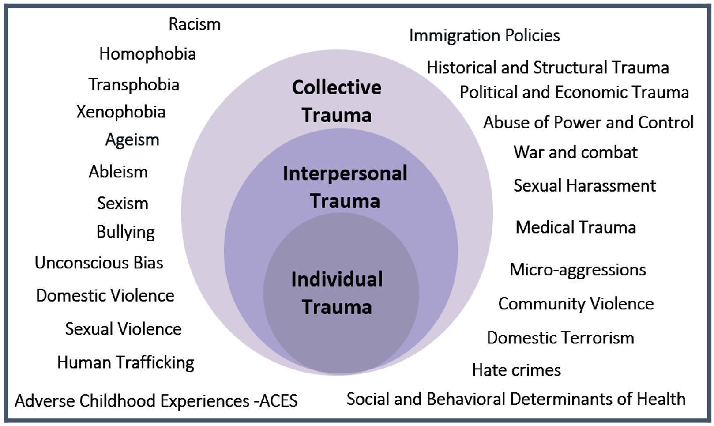
Trauma Graphic
Notes:
This especially because there has been a lot of recent research around the biopsychosocial impact in our genetic coding such as Youssef et als 2018 study which shows that trauma literally changes our DNA that is subsequently passed along into the next generations. This biologically inherited generational trauma has been studied to have sustained discriminatory impact across race, gender, poverty & violent incidents such as war as well as the other listed examples.

Slide 8
Oppression as a Form of Trauma
Impact of Oppression on Care
“addresses the whole person and the practitioner relates to the (student) in the (student's) social context. Therefore it considers how personal, institutional, cultural, & economic issues influence individuals' behaviors and their opportunities to grow into their full potential as persons living within these oppressive contexts.”
(Jude M. Hines, 2012)
Notes:
This is important to note because oppression is trauma and trauma hinders us from developing into our full potential both as individuals, as an identity based group, and thus as a society where these inequities deepen and become the status quo because we have not addressed the root trauma piece of oppression.
What is student success in this context?
Metrics of success determined by institutions are inherently not created for students of marginalized identities to succeed.

Slide 9
Oppression as a Form of Trauma
Race-Based Traumatic Stress
"Racial trauma refers to People of Color and Indigenous individuals' reactions to dangerous events and real or perceived experiences of racial discrimination, including threats of harm and injury, humiliating and shaming events, and witnessing racial discrimination toward other individuals. Although similar to posttraumatic stress disorder, racial trauma is unique in that it involves ongoing individual and collective injuries due to exposure and
re-exposure to race-based stress."
(Comas-Díaz, Nagayama Hall, & Neville, 2019)
Notes:
Racial Trauma: Theory, Research, and Healing: Introduction to the Special Issue, Lillian Comas-Díaz, Gordon Nagayama Hall, and Helen A. Neville

Slide 10
Healing Centered Approach
"holistically involves culture, spirituality, civic action and collective healing. A healing centered approach views trauma not simply as an individual isolated experience, but rather highlights the ways in which trauma and healing are experienced collectively."
(Shawn Ginwright, 2018)
Notes:
Link: https://medium.com/@ginwright/the-future-of-healing-shifting-from-trauma-informed-care-to-healing-centered-engagement-634f557ce69c

Slide 11
The Impact of COVID-19 on Marginalized Students

Slide 12
Healthy Minds Network
The Impact of COVID-19 on College Student Wellbeing
Two-thirds report their financial situation has
become more stressful.
Roughly one-third report that their living situation
changed as a result of the pandemic.
40% report witnessing race-based discrimination
either in person or online.
60% indicate that the pandemic has made it more
difficult to access mental health care.
(American College Health Association, 2020)
Notes:
Symptoms of mental health conditions remain high in college student populations, both before and after the start of the pandemic. Relative to fall 2019, the prevalence of depression increased and substance use decreased in spring 2020. In March through May 2020, a higher proportion of students report that their mental health negatively impacted their academic performance. While students report lower levels of psychological wellbeing post-pandemic relative to Fall 2019, they also reported higher levels of resiliency.
Link: https://mhttcnetwork.org/centers/mountain-plains-mhttc/news/impact-covid-19-college-student-well-being

Slide 13
Black, Indigenous, Students of Color
Undergraduate Wellbeing During a Pandemic
Asian students felt a little less certain about their intellectual and social fit at the university, more anxious about confirming negative stereotypes about their identity group(s), and less satisfied with life during the pandemic than they felt a year prior.
Black students felt more self-assured.*
Multiracial/Multiethnic students felt a little less healthy and more anxious about confirming negative stereotypes about their identity group(s).
No notable differences between pandemic and normal circumstances among Latinx (or White) students.
(University of Oregon, 2020)
Notes:
There’s a lot around advocacy and political engagement, but could not find relevant data isolating international student experiences let alone DACAmented students. Which in itself is othering and marginalizing.
Survey conducted in May 2020, before the elevated and recent protests around BLM started occurring. The Steve Fund has launched a Task Force to Address COVID-19’s Impact on the Mental Health of Young People of Color: https://www.stevefund.org/press-release-steve-fund-launches-task-force-to-address-covid-19-impact-on-the-mental-health-of-young-people-of-color/
At this time, email Jimmy or Ritu for a copy of this report.

Slide 14
Lesbian, Gay, Bisexual, Trans, Queer, Questioning, Intersex, Asexual/Aromantic+ Students
COVID-19 Related Stress Among LGBTQIA+
University Students
44% hid their LGBTQ+ identity more often.
30% heard family make negative comments
about LGBTQ+ people more often.
36% were cautious about their actions around heterosexual/straight people more often.
32% of transgender/nonbinary students reported disrespect of their gender identities more often.
37% experienced an increase in white LGBTQ+ people saying things that were racist.
43% were spending more time educating
white LGBTQ+ people about race.
(University of Maryland, 2020)
Notes:
Highlight that this is an *increase* from the already established amounts of discrimination these students are facing. Which means our queer students are having to “go back in the closet” or minimize their identity for safety reasons which has a direct correlation to elevated risks of emotional distress and suicide.
UMG Study Link: https://sph.umd.edu/news-item/lgbtq-college-students-face-significant-psychological-distress-during-covid-19-pandemic-0
The Trevor Project findings on youth (not just college students): https://www.thetrevorproject.org/2020/04/03/implications-of-covid-19-for-lgbtq-youth-mental-health-and-suicide-prevention/

Slide 15
Students with Disabilities
The COVID-19 Transitions Student Experiences
56% had difficulty receiving previously approved accommodations.
79% had difficulty possessing needed equipment and devices.
72% had difficulty accessing needed technology support and/or training.
58% had difficulty accessing and receiving academic support and tutoring.
61% had difficulty accessing counseling and mental health services.
75% had difficulty communicating with their course instructors.
(Association on Higher Education and Disability (AHEAD), 2020)
Notes:
Such high rates when pre-COVID students were navigating classrooms and campus cultures that aren’t ability-inclusive. So during the pandemic, who are we unintentionally pushing out of our student demographics because they are not able to stay in school due to these barriers.
Also want to note there have been recent advocacy around the intersectionality of folks with disabilities that aren’t often hear as common narratives. For e.g: Black & African American deaf & HH folks have their own dialect within American Sign Language, which isn’t necessarily considered when we are adapting our materials to ASL.
Higer Ed resources for pracitioners around addressing disability.
AHEAD Infographic Link: https://higherlogicdownload.s3.amazonaws.com/AHEAD/38b602f4-ec53-451c-9be0-5c0bf5d27c0a/UploadedImages/COVID-19_/Documents/AHEAD_Infographic_Series_-_Student_Experience_2_1_.pdf
https://www.ndrn.org/issues/covid-19/
https://www.nccsdclearinghouse.org/covid-19-resources.html

Slide 16
Impact of Socio-Economic Status
Undergraduate Wellbeing During a Pandemic
First-Generation undergraduates felt a little less satisfied with life during the pandemic than they felt a year prior.
Undergraduates with lower socioeconomic backgrounds felt a little less satisfied with life.
Undergraduates with upper socioeconomic backgrounds felt a little lonelier, sadder, and less like they had peers with whom they could interact socially.
(University of Oregon, 2020)
Notes:
At this time, email Jimmy or Ritu for a copy of this report.
Financial Stressors
Housing insecurity / study supportive spaces (or even safety if in not stable living environments) if staying with many others.
Lack of access to tech
"Self-Care" is inaccessible, healthcare services less available (for themselves and/or loved ones especially if in caregiving roles).

Slide 17
Defining Crisis

Slide 18
What Is a Crisis?
"A crisis is an emotional and physical response to some precipitating event or series of events that disrupts our normal day-to-day functioning."
(Hybels-Steer, 1995)

Slide 19
Impact of a Crisis?
Depends on:
The individual’s perception of the event as the cause of considerable upset and/or disruption.
The individual’s inability to resolve the disruption through coping mechanisms.
(Roberts & Yeager, 2007)

Slide 20
Types of Crisis?
Single-Episode Exposure
  Natural disasters, auto accidents, surgeries, crimes, and loss of loved ones.
Cumulative/Multiple Exposure
  Traumatic life experiences that are cumulative
  in nature.
Deliberate Cumulative/Multiple Exposure
  Prolonged stressors deliberately inflicted by
  other people.
(Roberts & Yeager, 2007)

Slide 21
Stress is a part of every student's life.

Slide 22
WHAT IS YOUR ROLE?
Notice
Engage
Refer

Slide 23

NOTICE
Notice signs of distress and communicate these
to the student and/or supervisor.

Slide 24
Stress: Causes for Concern
Uncharacteristic changes in academic performance
Uncharacteristic changes in attendance at class or meetings
Depressed or lethargic mood
Hyperactivity and/or rapid speech
Social withdrawal

Slide 25
Stress: Causes for Concern
Marked change in personal dress, hygiene, eating and/or sleeping routines
Repeatedly falling asleep in class
Requests for special consideration, especially if the student is uncomfortable talking about the circumstances prompting the request
New or recurrent behavior that pushes the limits of decorum and that interferes with the effective management of your class, work team, etc.
Unusual or exaggerated emotional response to events

Slide 26

ENGAGE
Have a direct conversation with the student to gather
more information, actively listen & express your care
and concern if you are comfortable doing so.

Slide 27
Have A Direct Conversation
Start with the student
Set & respect boundaries
Self-care

Slide 28
Goals of the Conversation
Assess for safety
Collaborate with student around priorities
Share information and referrals
Allow students to define success
Empower students toward self-advocacy
Consider cultural context
Center student's reality
Care without judgement
Notes:
1. Assess for safety on an ongoing basis
2. Provide services under the FERPA (Family Education Rights and Privacy Act) definition of privacy and our social work licenses
3. Provide short-term case management and possibly long-term follow-up with the goal to minimize the health concern’s impact on their academics
• Check-in with student via direct outreach
• Coordinate services from other campus or community spaces
• Provide access to Food Insecurity Resources, if appropriate
• Provide access to Dean of Student Crisis fund, if appropriate
4. Services are defined by student and student’s context unless there is an imminent safety concern
5. Facilitate academic modification or assistance from professors or department
6. Connect student to long-term campus or community healing services

Slide 29
Privacy
It is important to maintain privacy with respect
to your interaction with the student.
Avoid making sweeping promises of confidentiality.
In circumstances where people are at risk of harming themselves or another person, it is necessary to breach privacy to ensure the safety
of the person.

Slide 30

REFER
Be knowledgeable of your institutional policies
and resources to appropriately and empathetically refer
the student to the support they deserve.

Slide 31
Considerations for Action
What is the impact?
What is the level of concern?
Situational Awareness & Need to Know
Balance of Laws & Institutional Policy

Slide 32
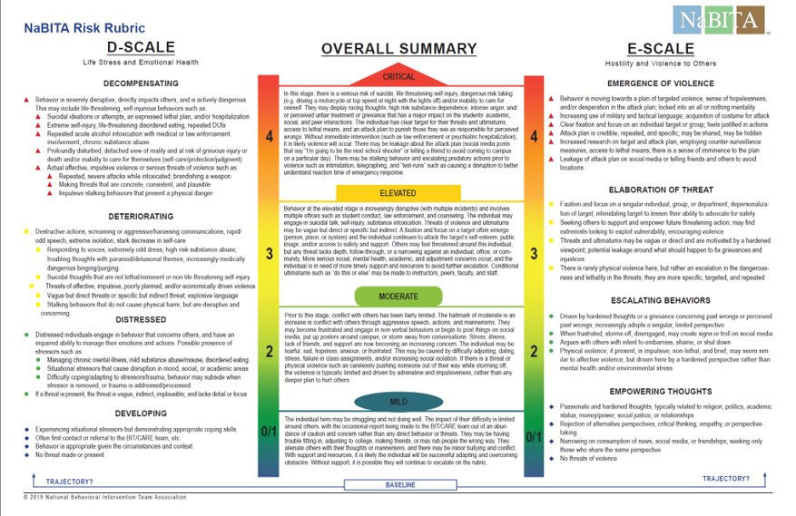
National Behavioral Intervention Team Association (NaBITA) Risk Rubric
National Behavioral Intervention Team Association (NaBITA) Risk Rubric
Notes:
Link: https://www.nabita.org/resources/threat-assessment-tools

Slide 33
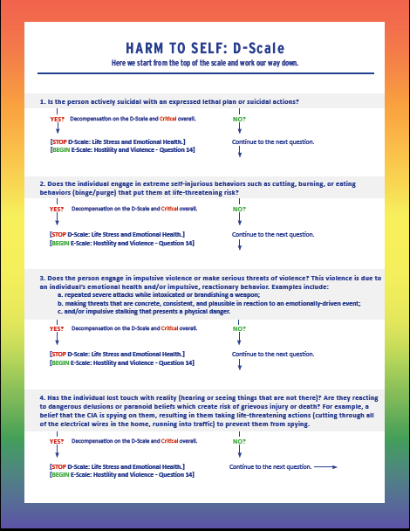
Harm to Self Scale
Notes:
Link: https://cdn.nabita.org/website-media/nabita.org/wp-content/uploads/2019/06/27201501/NaBITA-Risk-Rubrick-Flowchart-FInal.pdf

Slide 34
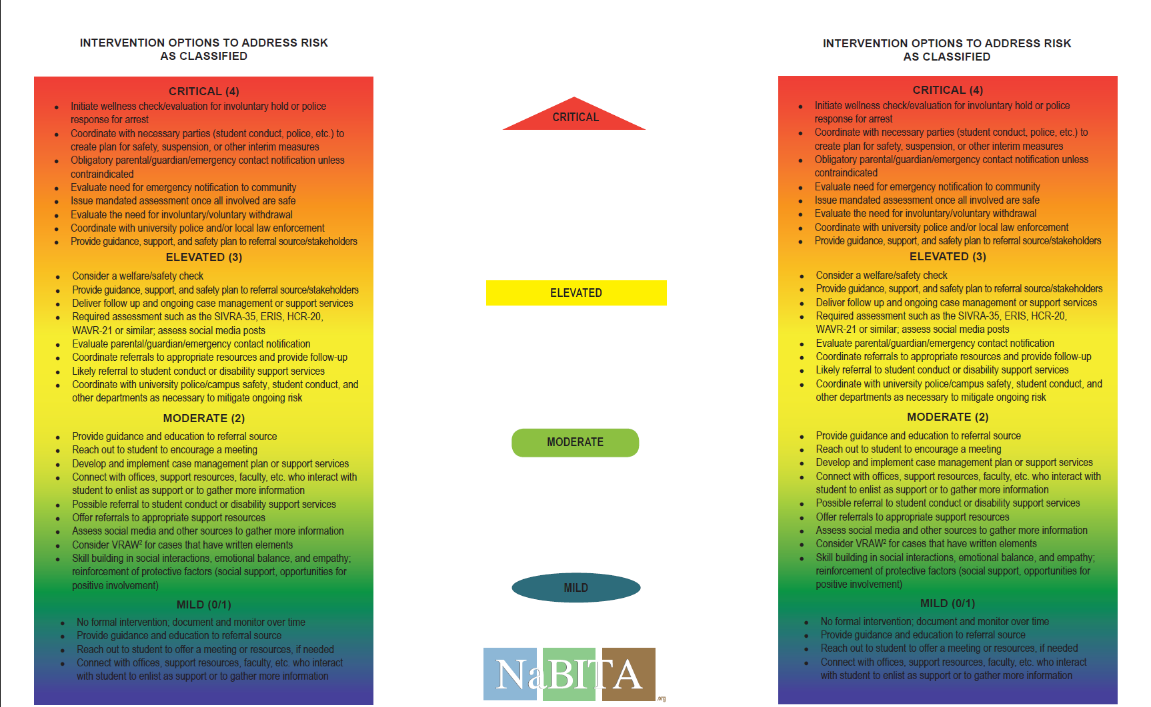
SUGGESTED INTERVENTIONS

Slide 35
Interventions
Referral to University and/or Community Resources
Emergency Funding
Withdrawals
Mandatory Leave
Care Outreach
Administrative Care Meeting
Supportive Academic Measures
Emergency Contact Notification
Welfare Check
Notes:
1. Assess for safety on an ongoing basis
2.Provide services under the FERPA (Family Education Rights and Privacy Act) definition of privacy and our social work licenses
3.Provide short-term case management and possibly long-term follow-up with the goal to minimize the health concern’s impact on their academics
4.Services are defined by student and student’s context unless there is an imminent safety concern
5.Facilitate academic modification or assistance from professors or department
6.Connect student to long-term campus or community healing services
1. Assess for safety on an ongoing basis
2. Provide services under the FERPA (Family Education Rights and Privacy Act) definition of privacy and our social work licenses
3. Provide short-term case management and possibly long-term follow-up with the goal to minimize the health concern’s impact on their academics
• Check-in with student via direct outreach
• Coordinate services from other campus or community spaces
• Provide access to Food Insecurity Resources, if appropriate
• Provide access to Dean of Student Crisis fund, if appropriate
4. Services are defined by student and student’s context unless there is an imminent safety concern
5. Facilitate academic modification or assistance from professors or department
6. Connect student to long-term campus or community healing services

Slide 36
Boundaries & Balance
In The Workplace
Notes:
What does it mean to set boundaries and have balance in the workplace, especially for staff that hold identities that have been oppressed.
Experiences of trauma - lead to feeling powerless. I believe the way to reconcile having power as administrators and practitioners with feeling powerless based on our personhood is to center healing for all of us.
Part of gaining that power back should be on us doing this personal work of critically conscious self-care, as it will impact how we show up professionally. Even in my oppression, I’m constantly recognizing how I have had the opportunity to work on or transcend some of my trauma. Especially in thinking through what privileges I hold to utilize as having more power (including working in higher ed/educational & training opportunities) to be an ally to my own communities on the margins.
In the interest of time, we’ll be focusing primarily on quick tips and pointers I’ve highlighted as important. The slides have more detailed content for you to peruse later.

Slide 37
Understanding Your Responses
Vicarious Trauma, Compassion Fatigue, Burnout
Vicarious Trauma - the profound shift in world view that occurs when helping those who have experienced trauma. One's fundamental beliefs about the
world are altered and possibly damaged by being repeatedly exposed to traumatic material.
(Pearlman, & Saakvitne, 1995)
Compassion Fatigue - the profound emotional and physical erosion that takes place from being unable to refuel and regenerate when supporting others.
It has been described as the “cost of caring” for others in emotional pain.
(Figley, 1982)
Burnout - the emotional, physical, and mental exhaustion caused by
excessive and prolonged stress. Burnout is a gradual process and leads
to an overwhelming feeling of "not enough," powerlessness, fatigue
and a sense of being worn out.
(Smith, Segal, & Robinson, 2019)
Notes:
VT/CF/Burnout are separate symptoms of a potentially interconnected problem. Recognize what parts of your experience are specifically one or a combination of them.
Note: burnout can be easily resolved. For e.g: changing jobs can provide immediate relief to someone suffering from job-related burnout which is not the case for CF and VT that need intentional reflection and care to work through.
As a mental health professional, I always recommend therapy for building your coping skills and response toolkit. At the very least for all, but esp. VT you need trusted/supportive/non-toxic loved ones and chosen family to help with rebuilding and reframing to a more positive or healthier mindset and consequently the actions to maintain that mindset.

Slide 38
Understanding Your Responses
Maintaining your ABCs
Awareness
Take time to self reflect. Journal, seek out therapy, talk with loved ones, check in with trusted colleagues or a mentor to help build self-awareness.
Balance
Maintain work-life boundaries by developing non-trauma related interests and hobbies. Relaxing meditation, quiet activities, or exercise can be emotionally restorative. Taking take time for yourself is not selfish, it’s necessary.
Connection
Having supportive people in our lives can help reduce isolation and give opportunities to share feelings or experiences. It is also an important way to develop and nurture trusting relationships, which directly help address vicarious trauma and compassion fatigue.
Notes:
Strategies on how to cope by maintaining your ABCs.

Slide 39
The Personal Is Political Is Professional
The unique experiences of marginalization
Visibility On/Off Campus
- Feeling “On” and experiencing hyper vigilance.
Invisible Identities
- Reactions not validated in the workplace.
Politics In The Workplace
- Compromising which may be viewed as
hypocrisy or institutional betrayal.
Personal Impact
- External assumptions influence action.
- Tasked with extra work without compensation.
- Constantly assessing safety of disclosure.
- Tension of self-advocacy and guilt of being quiet.
- Balancing amiable working relationships without
compromising non-negotiable values.
- Being “professional” in reactions and responses.
- Mistrust around others’ intentions and actions.
- Difficulty empathizing with other experiences.
Notes:
The phrase, “the personal is political” comes from the title of an essay by Carol Hanisch, Notes from the Second Year: Women's Liberation in 1970. Though it has been most often championed within black feminist movements.
I’ve determined these categories based off of my personal experiences and in conversation with colleagues. All of these lead to extra brain power, and heightened feelings of insecurity and anxiety which can have us feel more drained and less productive. Ultimately deemed as less good at our jobs when many of us already feel held to higher standards and being representatives of our communities, thus it may heighten that sense of imposter syndrome.
---- Strategies -----
In/Visibility ~ These two I consider the impact of being put in a box (because of people’s assumptions of you).
Visibility
Always feeling "on" that can lead to hyper-vigilance and not being able to turn it off even if you want to.
- Which is exhausting and can lead to longer term issues around performing inauthentically (as a mask of yourself), difficulty trusting, symptoms related to post-traumatic stress (it doesn’t have to be a formal PTSD diagnosis to impact you negatively).
Others' assumptions influence how your actions and thoughts are perceived and having to prepare/think about that as additional brain power.
- The internalization of others' positive and negative assumptions of you.
- Navigating how you “fit” and don’t into these stereotypes/tropes | community and individual experiences aren’t a monolith.
Being tasked with additional roles of educating without compensation, often framed as opportunities for leadership or service to your community. This can lead to a sense of guilt/not doing enough also.
Invisibility
Having reactions in the workplace that are not validated because folks may not understand what and why is causing you to be emotionally activated.
- Ignorance (both of your identity and not being educated) of colleagues can unintentionally and unexpectedly throw you off which also impacts being able to go back into “work-mode” especially if you’re doing emotional labour of supporting peers and students.
- Who you supervise and students you work with being micro-aggressive (and even experiencing macro aggressions) whilst also being in an institutional position of power.
Constantly assessing the safety of a space to share invisible identities, especially if colleagues aren’t directly or indirectly communicating that they are a person who can support you.
- E.g: Using inclusive language pertinent to a variety of marginalized identities (pronouns & updated terms used within the LGBTQIA identities, appropriate dis/ability terminology, etc.)
For both - the tension of advocating for yourself or letting things slide; the guilt of hiding or not sharing them.
Maybe it isn't important to you specifically, but it doesn't mean other folks in your community couldn't be hurt or annoyed.
- Additional burden of needing to constantly be updated on issues/concerns and impact to your community. This even in areas you might not be well-versed in and put in positions of needing to “speak to” and advocate for. Burden of navigating being called out/in in your own communities and not feeling like you have the opportunities for “failure”/growth from messing up.
Maybe, it just wasn’t worth the effort to call you out/in especially if you are not in brain space to hold accountability conversations. Sometimes, it's more exhausting for a marginalized person to have a “respectful” conversation or hold everyone around them accountable for every little thing.
- It's constantly navigating the trade-off between carefully managing others' fragility (because it is pinned on you for adding that tension to the relationship) or letting it go because “atleast these folks of privilege generally get it” or are overall supportive. Ties into the next two categories of needing allyship support.
Marginalized folks are trained and raised to keep shut and stay small thanks to oppression. It's the easier, hard pill to swallow than speaking up or taking up space - which let’s be real can have violent consequences for specific communities in society.
For these, the main themes to ask yourself are –
Do you get a break or are you constantly being (T)asked to do extra work/roles (volunteered time?)
Do you feel safe and supported to share OR be the multitude of your experiences that you want to bring into your professional self?
----------
Personal Political ~ For these, I think it adds to imposter syndrome and performance anxiety especially in the nuance that you are navigating inter-connected anger/pain in the workplace with high workloads and unchanged deadlines; I doubt many of us can afford to lose our jobs for a variety of reasons.
Personal parallel impact
You’re experiencing the same issues and concerns that you are supporting your students (and colleagues) with and still have this pressure to “hold it together” as a response to internalizing (the assumptions noted above) needing to have higher standards/proving ourselves more at the workplace because of holding marginalized identities.
Being "professional" in your reactions and responses and along with visibility having to watch what your public professional image is communicating.
- Feeling overwhelmed or hopeless whilst remaining a support system for students, supervisees, or peers that turn to you.
Balancing feeling mistrustful of intentions whilst recognizing the need for collective action (and accountability).
- It is on allies/folks with privilege to do the work of recognizing their impact & intention is having on their colleagues and thus students (who will be influenced by how their mentors/staff of marginalized identities rightfully view engaging with them.
Difficulty holding empathy for students or colleagues with privilege who you continue to engage with in your daily roles.
Political Nature
May have to make strategic choices and compromises which others may view as "institutional betrayal" or hypocritical.
E.g: The tension of holding both prevention & response roles.
Maintaining working relationships with others whose viewpoints counter yours and assessing which are non-negotiables.
- These values can range from faith, personal ethics, political viewpoints etc.
- It shouldn’t just be bare minimum of others not doing intentional hurt/harm, but centering what really matters to you, makes you feel valued and supported by others.
Folks in your own communities or engaging in anti-oppressive action feel differently about response and support. Managing internal politics with the external focus being around change.
E.g: abolitionists vs. reformists.

Slide 40
The Personal Is Political Is Professional
Critical Moments of Reflection
Which students are accessing you and why?
Who is the work you’re doing serving?
How is the impact of your work positive?
Do you have the capacity to continue?
Notes:
Personal benefits aren't inherently a bad thing, but important to reflect critically on the reasons you feel empowered and what keeps you motivated to show up at work - for your colleagues and absolutely for your students.
If we didn't feel empowered or good by what we did, we wouldn’t continue to do it. A part of continuing to do “good work” is to always interrogate our intentions and actions. If we are committed to anti-oppressive work (not provide/uphold bandaid solutions), we must ultimately or at least partially dismantle the institutions and structures that uphold these systems; including the institutions that employ us to do our work which is an elevated risk and anxiety inducing that folks with privilege do not experience!
---- Strategies -----
Which students are accessing you and why?
Do ALL students feel comfortable coming to you?
Are you inherently tacking on your own personal assumptions of that student to their experience? Even for those within your community.
- E.g: the assumption that your student is straight even with your good intentions is communicating lack of comprehensive support to that student.
Which student populations are NOT engaging with your office or you?
- Even if they do come to you, many may not be disclosing the entirety of their experiences if they don’t know how you’ll respond.
Which students experiences are you considering as a form of marginalization?
- E.g: what about “non-traditional” identified students?
Have you and how do you practice intentional outreach and engagement to build trust with students that do not hold your own identities?
- Subtle and quick cues can be: signage, email signatures, inclusive language (around pronouns, disability, wellness culture)
Who is the work (you’re doing) serving?
Beyond wanting to “do good” do you have the appropriate skill set or qualifications?
- Acknowledging we often don’t have the time, energy, resources to have ongoing training or understanding what current best practices are. Even with these opportunities – it’s based on whether you have the capacity to attend.
- E.g: Variance of codes of ethics based on educational background or lack of standardized training is a real concern. I’ve noticed this mostly around staff/faculty understanding and therefore respecting FERPA.
Is there any personal gain – tangible/social status/internal? Or self-martyrdom?
- This can feel prickly to think through, especially when we are running on empty and trying our best.
- I want acknowledge how this can also be a valid trauma response from the institutional level of how other departments/colleagues may have failed you in the past to our more personal lived experiences of not trusting folks with privileged identities.
- The reality is I’ve noticed often how much we become personally invested in for lack of a better word “saving our students” and not believing that others can be as helpful to them (which often is a disservice to the student)
- E.g: A common concern I’ve been hearing is, “What will people think of me if I don’t post this / not posting on my social media about social justice issues?” whilst me also gently having them think critically as to what & how their actions are impactful centering the community needs.
How is the impact of your work positive?
Are you contributing towards sustainable change that will reduce future harm?
Are you actively interrogating your values and belief systems; do you engage with folks of different faith or ethical perspectives? Subsequently how those impact your work?
- What if they are vilified in society/media or you believe they *should* be acting a certain way to gain respect/positive representation?
- E.g: personal experiences or perspectives about people of different ethnocultural or immigration backgrounds?
Are you engaging in ongoing learning and implementing these new concepts into your work?
- E.g: including pronouns in your forms/documents (organizational) and your introductions (personal)
Do you have the capacity to continue?
Are you committed to ongoing learning that forces you to sit in discomfort?
Can you complete all your commitments within deadlines?
- Another form of institutional betrayal is not being able to follow-through on already established expectations.
Are you experiencing VT, CF or burnout and are you able to make time to recharge?

Slide 41
Support at the Workplace
Individual
Organizational (Supervisor Support)
Instititutional
Societal
Community
Notes:
A fantastic worksheet for care practice in the workplace using the socio-ecological model from the Oregon Sexual Assault Taskforce (this can be requested from OSATF, this webinar works through the framework and provides ways of accessing all the resources mentioned: https://oregonsatf.org/webinar/prevention-gets-personal-compassion-fatigue-and-vicarious-trauma-in-prevention-work/
---- Notes -----
The problem with self-care is that it puts the onus on the individual without recognizing the faults of systemic oppression and toxic workplace cultures. It often coopts indigenous or BIPOC spiritual practices and marketed as a commodity for profit. "You can't meditate away racism no matter how nice your lululemons are.“
All of these take effort, intention, and energy and essentially is practicing boundaries around what you are and are not able to do. When you’re in a place of frustration/disenfranchisement/hopelessness this can feel unsurmountable. Healthy and supportive relationships (which includes trusted colleagues/mentors) and access to culturally mindful mental health resources are essential to being able to take these actions.
Individual
Utilize mental health resources for your own personal enrichment that will positively impact your professional growth.
Practice consistent rituals to indicate being “on and off the clock” and carve out time for self-care practices when working.
- E.g: Taking a walk around the block/an accessible action before starting/after ending work.
- E.g: A morning routine that transitions from taking care of yourself (washing your face etc) to work mode (making & drinking your coffee).
Role model for supervisees/peers those values or actions which lead to healthy, inclusive & equitable workplace dynamics.
Seek opportunities for continued learning to provide more comprehensive and intersectional support.
Organizational (Supervisor Support)
Incorporation of student support work as part of your job.
Acknowledgment/compensation of the additional roles or work you do outside of the direct scope of your job duties.
Flexibility in work expectations that support your wellness and lifestyle.
- E.g: not adhering to an “8 to 5” / flexible hours ~ starting/working late to have more time with children.
- E.g: allowing for personal time and self-care into work instead of around work. Such as your regular health scheduled during the work week.
Community
Participate or create identity-specific community initiatives that range from wellness to professional development.
- E.g: opportunities for venting or “letting it all out” where you are authentically creating/finding/providing opportunities for folks (students & colleagues) to share authentically (including anonymously sharing).
Encourage or organize direct action or mutual aid opportunities, including bringing in peer educators trained in issues of emotional distress, mental health crises, suicide, substance misuse & abuse, & sexualized or familial violence.
Coalition building with allies around actions that directly support your individual - institutional level goals.
Institutional
Human Resources employee assistance and wellness resources that are free.
- Note: financial management should be a part of wellness especially because so many marginalized communities haven’t historically had the opportunities for financial success.
- E.g: consistently checking in with a retirement advisor.
Policy and advocacy opportunities such as diversity equity committees, union representation, etc. This can also be a part of what mutual aid can be.
Safety of reporting or accessing confidential options around issues of workplace discrimination.
- E.g: Do you know about how to access your Ombuds Office and the services they provide?

Slide 42
Contact
For follow-up questions or a full list of resources and toolkits, please contact:
Jimmy Howard jhoward8@uoregon.edu
Ritu Roy ritu@uoregon.edu

